Slide 1
UNIT-4
Machine Learning
Unsupervised Learning

Slide 2
Supervised learning vs. unsupervised learning
Supervised learning: discover patterns in the data that relate data attributes with a target (class) attribute.
  These patterns are then utilized to predict the values of the target attribute in future data instances
Unsupervised learning: The data have no target attribute.
  We want to explore the data to find some intrinsic structures in them.

Slide 3
What is Cluster Analysis?
Finding groups of objects in data such that the objects in a group will be similar (or related) to one another and different from (or unrelated to) the objects in other groups
Inter-cluster distances are maximized
Intra-cluster distances are minimized

Slide 4
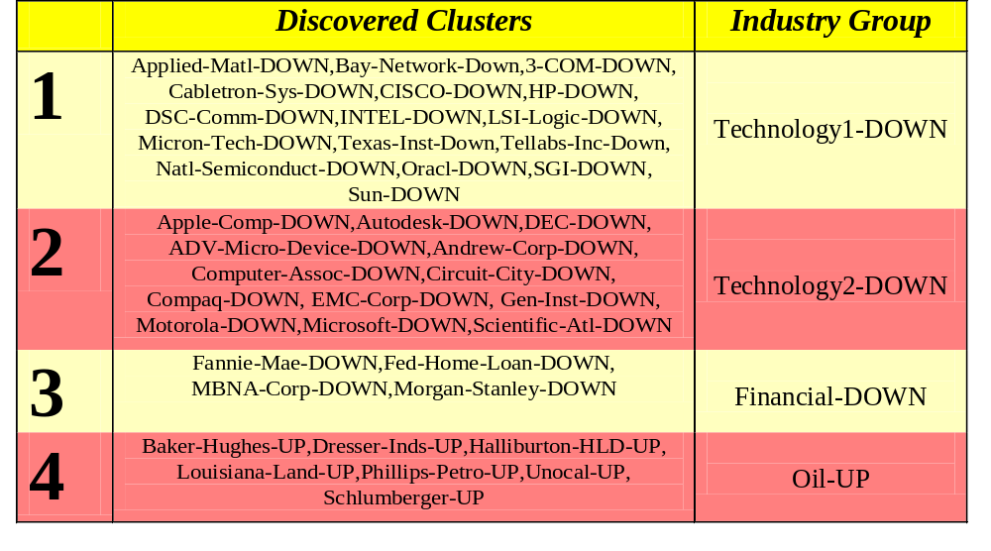
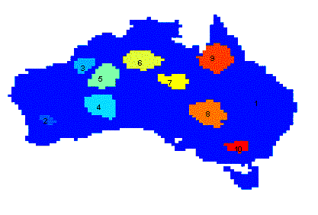
Applications of Cluster Analysis
Understanding
  Group related documents for browsing, group genes and proteins that have similar functionality, or group stocks with similar price fluctuations
Summarization
  Reduce the size of large data sets
Clustering precipitation in Australia

Slide 5
Types of Clusterings
A clustering is a set of clusters
Important distinction between hierarchical and partitional sets of clusters
Partitional Clustering
  A division data objects into non-overlapping subsets (clusters) such that each data object is in exactly one subset
Hierarchical clustering
  A set of nested clusters organized as a hierarchical tree

Slide 6

Partitional Clustering
Original Points
A Partitional Clustering

Slide 7
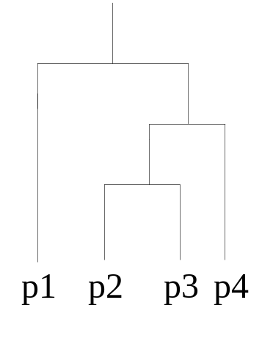
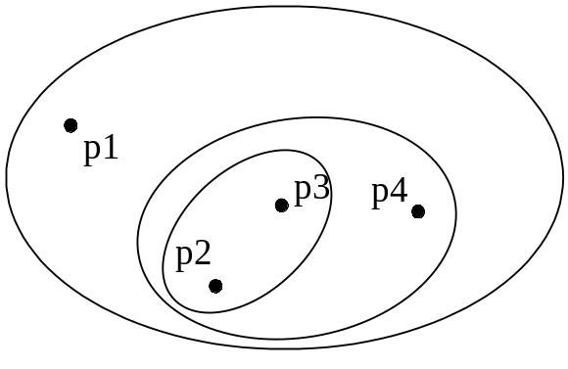
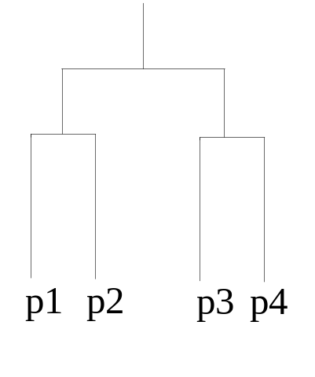
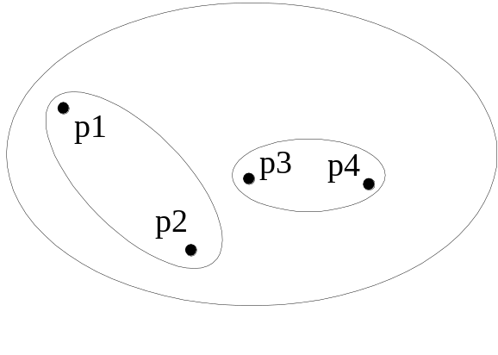
Hierarchical Clustering
Traditional Hierarchical Clustering
Traditional Dendrogram
Non-traditional Hierarchical Clustering
Non-traditional Dendrogram

Slide 8
Clustering Algorithms
K-means and its variants
Hierarchical clustering
Density-based clustering

Slide 9
K-means clustering
K-means is a partitional clustering algorithm
Let the set of data points (or instances) D be
{x₁, x₂, …, x_{n}},
  where x_{i} = (x_{i1}, x_{i2}, …, x_{ir}) is a vector in a real-valued space X ⊆ R^{r}, and r is the number of attributes (dimensions) in the data.
The k-means algorithm partitions the given data into k clusters.
  Each cluster has a cluster center, called centroid.
  k is specified by the user

Slide 10

K-means Clustering
Basic algorithm

Slide 11
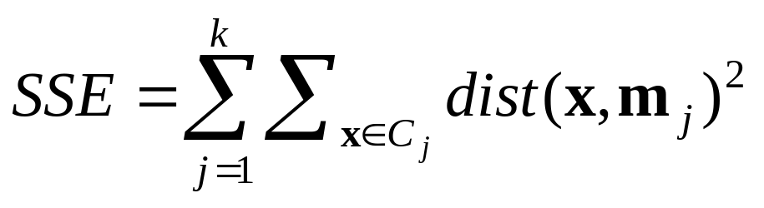
Stopping/convergence criterion
no (or minimum) re-assignments of data points to different clusters,
no (or minimum) change of centroids, or
minimum decrease in the sum of squared error (SSE),
  C_{i} is the jth cluster, m_{j} is the centroid of cluster C_{j} (the mean vector of all the data points in C_{j}), and dist(x, m_{j}) is the distance between data point x and centroid m_{j}.

Slide 12
K-means Clustering – Details
Initial centroids are often chosen randomly.
  Clusters produced vary from one run to another.
The centroid is (typically) the mean of the points in the cluster.
‘Closeness’ is measured by Euclidean distance, cosine similarity, correlation, etc.
K-means will converge for common similarity measures mentioned above.
Most of the convergence happens in the first few iterations.
  Often the stopping condition is changed to ‘Until relatively few points change clusters’
Complexity is O( n * K * I * d )
  n = number of points, K = number of clusters,
  I = number of iterations, d = number of attributes

Slide 13



Two different K-means Clusterings
Original Points
Optimal Clustering
Sub-optimal Clustering

Slide 14






Importance of Choosing Initial Centroids

Slide 15
Importance of Choosing Initial Centroids

Slide 16
Evaluating K-means Clusters
Most common measure is Sum of Squared Error (SSE)
  For each point, the error is the distance to the nearest cluster
  Given two clusters, we can choose the one with the smallest error
  One easy way to reduce SSE is to increase K, the number of clusters
    A good clustering with smaller K can have a lower SSE than a poor clustering with higher K

Slide 17
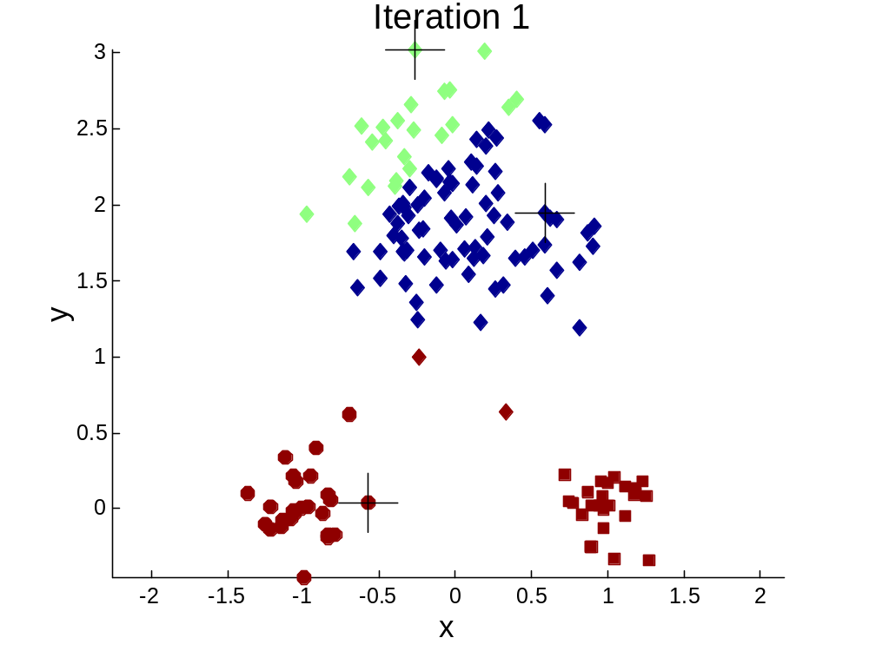


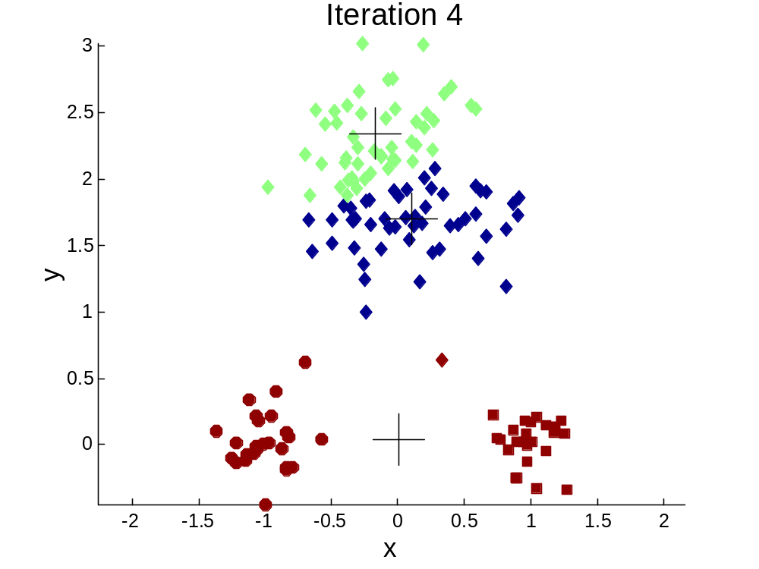
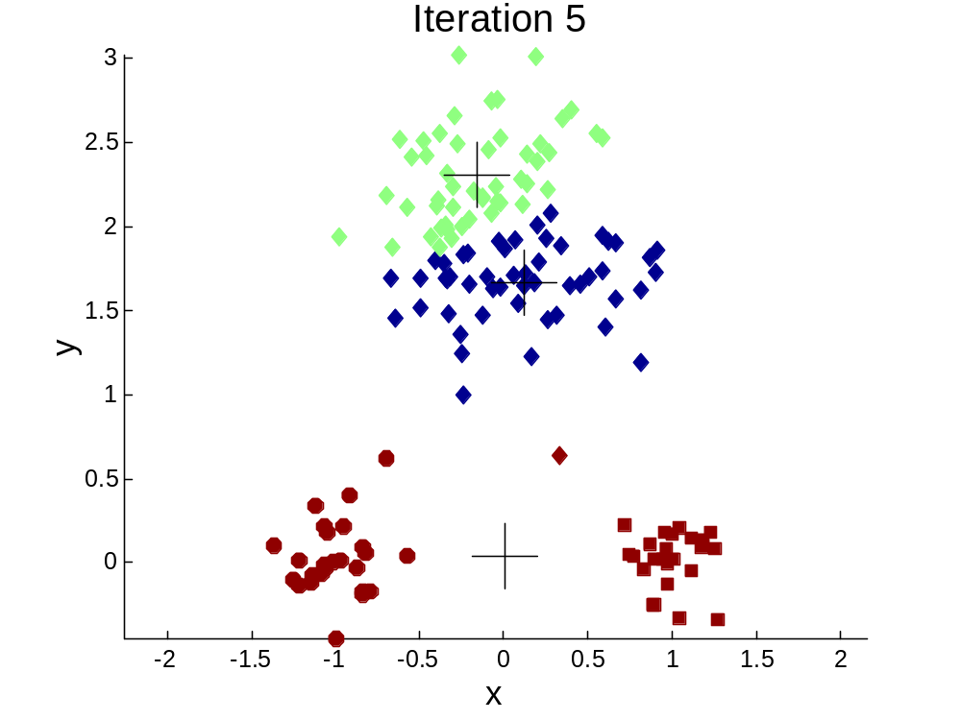
Importance of Choosing Initial
Centroids

Slide 18
Importance of Choosing Initial Centroids

Slide 19
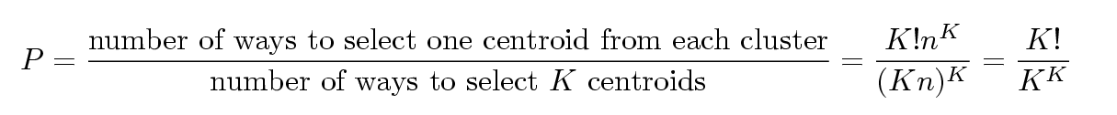
Problems with Selecting Initial Points
If there are K ‘real’ clusters then the chance of selecting one centroid from each cluster is small.
  Chance is relatively small when K is large
  If clusters are the same size, n, then
  For example, if K = 10, then probability = 10!/10¹⁰ = 0.00036
  Sometimes the initial centroids will readjust themselves in ‘right’ way, and sometimes they don’t
  Consider an example of five pairs of clusters

Slide 20
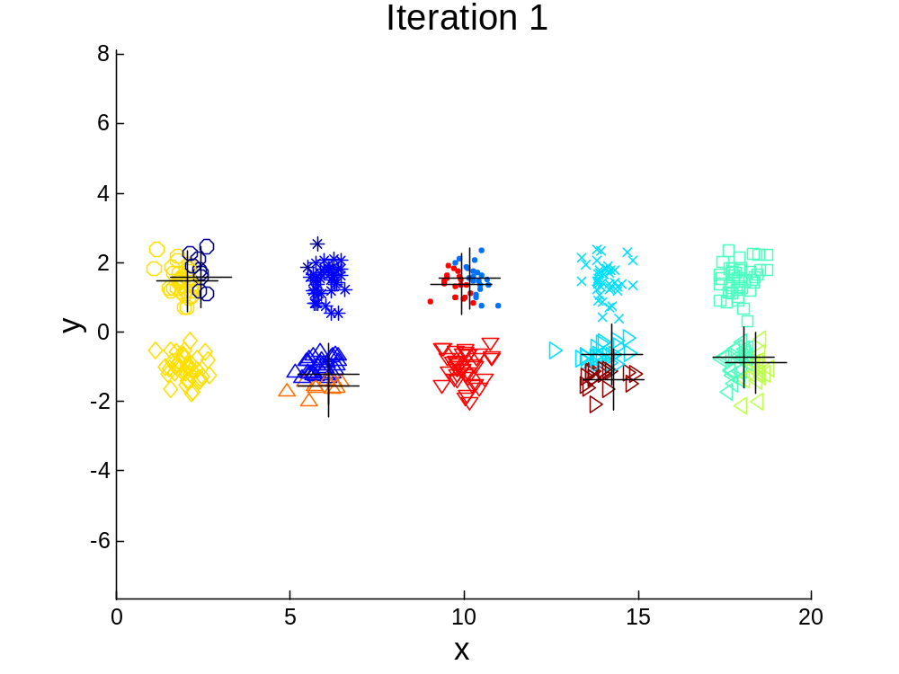
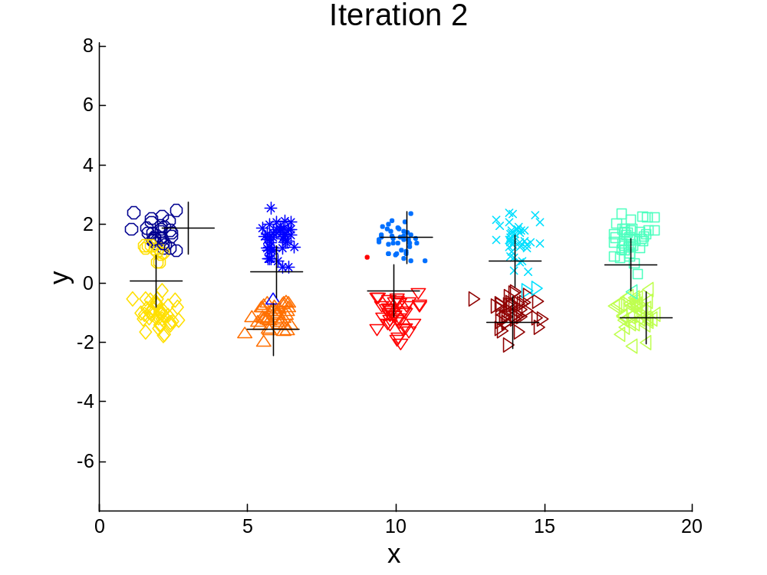
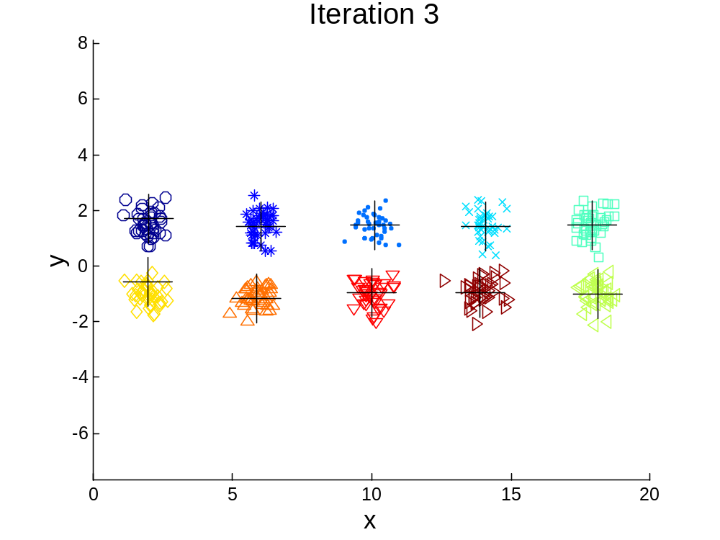

10 Clusters Example
Starting with two initial centroids in one cluster of each pair of clusters

Slide 21
10 Clusters Example
Starting with two initial centroids in one cluster of each pair of clusters

Slide 22
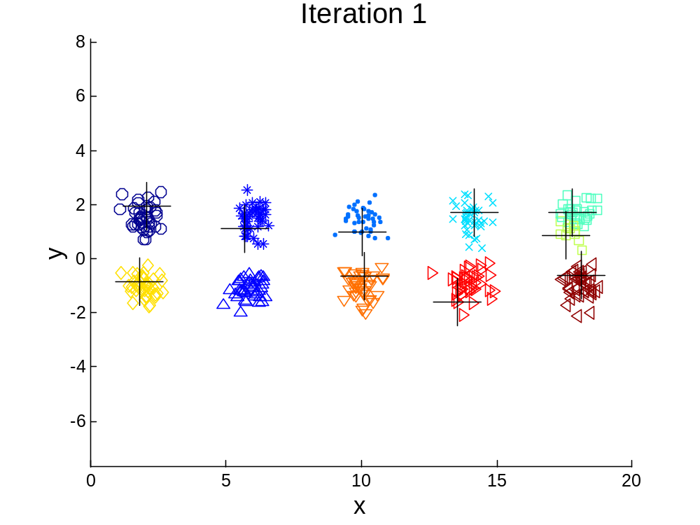



10 Clusters Example
Starting with some pairs of clusters having three initial centroids, while other have only one.

Slide 23
10 Clusters Example
Starting with some pairs of clusters having three initial centroids, while other have only one.

Slide 24
Solutions to Initial Centroids Problem
Multiple runs
  Helps, but probability is not on your side
Sample and use hierarchical clustering to determine initial centroids
Select more than k initial centroids and then select among these initial centroids
  Select most widely separated
Postprocessing
Bisecting K-means

Slide 25
Pre-processing and Post-processing
Pre-processing
  Normalize the data
  Eliminate outliers
Post-processing
  Eliminate small clusters that may represent outliers
  Split ‘loose’ clusters, i.e., clusters with relatively high SSE
  Merge clusters that are ‘close’ and that have relatively low SSE
  Can use these steps during the clustering process
    ISODATA

Slide 26
Limitations of K-means
K-means has problems when clusters are of differing
  Sizes
  Densities
  Non-globular shapes
K-means has problems when the data contains outliers.

Slide 27


Limitations of K-means: Differing Sizes
Original Points
K-means (3 Clusters)

Slide 28


Limitations of K-means: Differing Density
Original Points
K-means (3 Clusters)

Slide 29


Limitations of K-means: Non-globular Shapes
Original Points
K-means (2 Clusters)

Slide 30

Overcoming K-means Limitations
Original Points K-means Clusters
One solution is to use many clusters.
  Find parts of clusters, but need to put together.

Slide 31
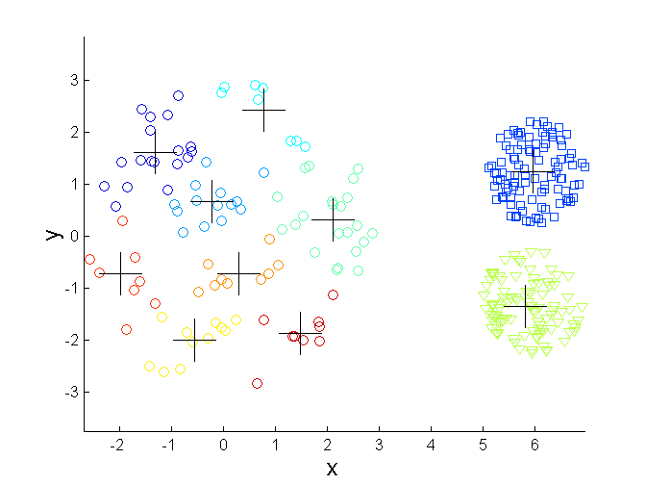
Overcoming K-means Limitations
Original Points K-means Clusters

Slide 32
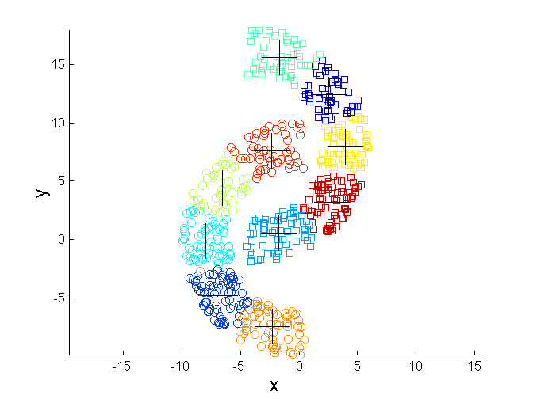
Overcoming K-means Limitations
Original Points K-means Clusters

Slide 33


Hierarchical Clustering
Produces a set of nested clusters organized as a hierarchical tree
Can be visualized as a dendrogram
  A tree like diagram that records the sequences of merges or splits

Slide 34
Strengths of Hierarchical Clustering
Do not have to assume any particular number of clusters
  Any desired number of clusters can be obtained by ‘cutting’ the dendogram at the proper level
They may correspond to meaningful taxonomies
  Example in biological sciences (e.g., animal kingdom, phylogeny reconstruction, …)

Slide 35
Hierarchical Clustering
Two main types of hierarchical clustering
  Agglomerative:
    Start with the points as individual clusters
    At each step, merge the closest pair of clusters until only one cluster (or k clusters) left
  Divisive:
    Start with one, all-inclusive cluster
    At each step, split a cluster until each cluster contains a point (or there are k clusters)
Traditional hierarchical algorithms use a similarity or distance matrix
  Merge or split one cluster at a time

Slide 36
Agglomerative Clustering Algorithm
More popular hierarchical clustering technique
Basic algorithm is straightforward
  Compute the proximity matrix
  Let each data point be a cluster
  Repeat
  Merge the two closest clusters
  Update the proximity matrix
  Until only a single cluster remains
Key operation is the computation of the proximity of two clusters
  Different approaches to defining the distance between clusters distinguish the different algorithms

Slide 37
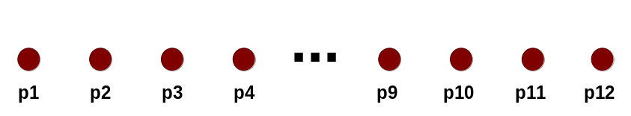
Starting Situation
Start with clusters of individual points and a proximity matrix
p1
p2
p3
p4
p5
. . .
p1
p2
p3
p4
p5
.
.
.
Proximity Matrix

Slide 38
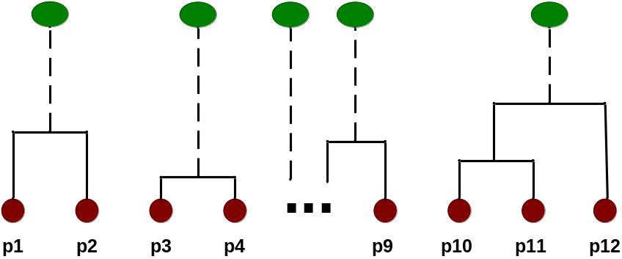
Intermediate Situation
After some merging steps, we have some clusters
C1
C2
C3
C4
C5
C1
C2
C3
C3
C4
C4
C5
Proximity Matrix
C1
C2
C5

Slide 39

Intermediate Situation
We want to merge the two closest clusters (C2 and C5) and update the proximity matrix.
C1
C2
C3
C4
C5
C1
C2
C3
C3
C4
C4
C5
Proximity Matrix
C1
C2
C5

Slide 40

After Merging
The question is “How do we update the proximity matrix?”
C2 U C5
C1
C3
C4
C1
?
C2 U C5
? ? ? ?
C3
C3
?
C4
C4
?
Proximity Matrix
C1
C2 U C5

Slide 41
How to Define Inter-Cluster Similarity
p1
p2
p3
p4
p5
. . .
p1
Similarity?
p2
p3
p4
p5
MIN
MAX
Group Average
Distance Between Centroids
Other methods driven by an objective function
  Ward’s Method uses squared error
.
.
.
Proximity Matrix

Slide 42
How to Define Inter-Cluster Similarity
p1
p2
p3
p4
p5
. . .
p1
p2
p3
p4
p5
MIN
MAX
Group Average
Distance Between Centroids
Other methods driven by an objective function
  Ward’s Method uses squared error
.
.
.
Proximity Matrix

Slide 43
How to Define Inter-Cluster Similarity
p1
p2
p3
p4
p5
. . .
p1
p2
p3
p4
p5
MIN
MAX
Group Average
Distance Between Centroids
Other methods driven by an objective function
  Ward’s Method uses squared error
.
.
.
Proximity Matrix

Slide 44
How to Define Inter-Cluster Similarity
p1
p2
p3
p4
p5
. . .
p1
p2
p3
p4
p5
MIN
MAX
Group Average
Distance Between Centroids
Other methods driven by an objective function
  Ward’s Method uses squared error
.
.
.
Proximity Matrix

Slide 45
How to Define Inter-Cluster Similarity
p1
p2
p3
p4
p5
. . .
p1
×
×
p2
p3
p4
p5
MIN
MAX
Group Average
Distance Between Centroids
Other methods driven by an objective function
  Ward’s Method uses squared error
.
.
.
Proximity Matrix

Slide 46
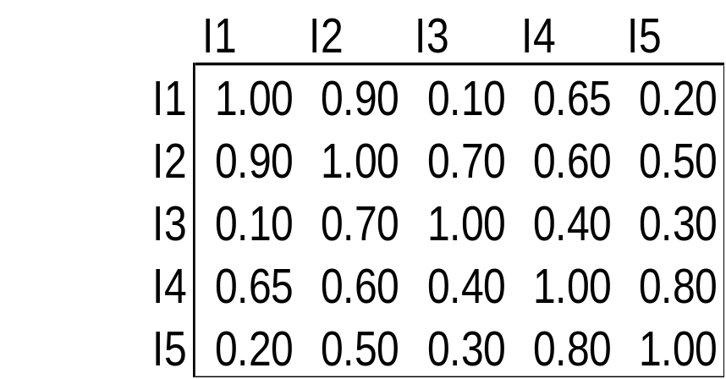
Cluster Similarity: MIN or Single Link
Similarity of two clusters is based on the two most similar (closest) points in the different clusters
  Determined by one pair of points, i.e., by one link in the proximity graph.
1
2
3
4
5

Slide 47

Hierarchical Clustering: MIN
5
1
3
5
2
1
2
3
6
4
4
Nested Clusters
Dendrogram

Slide 48
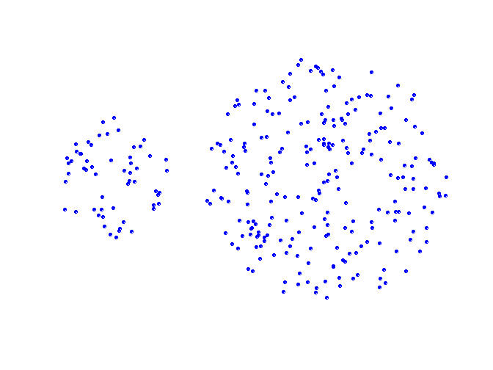
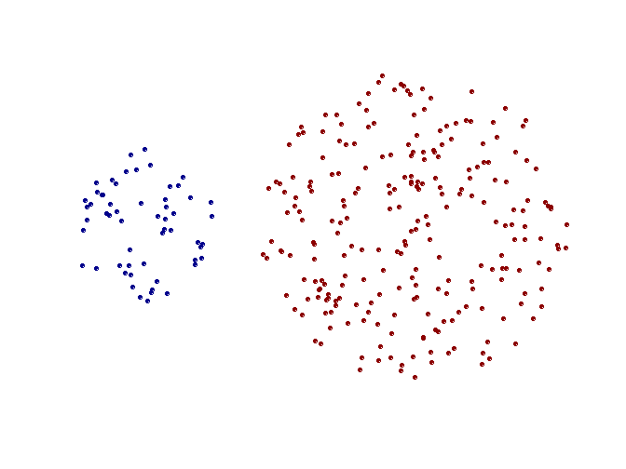
Strength of MIN
Original Points
Two Clusters
Can handle non-elliptical shapes

Slide 49
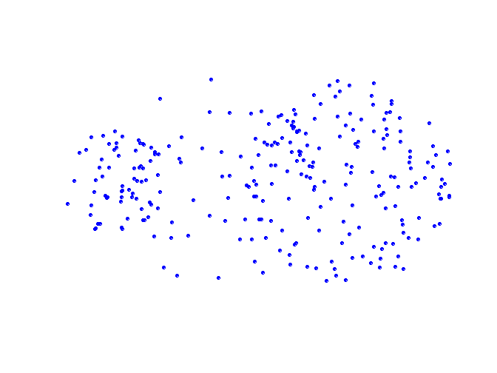
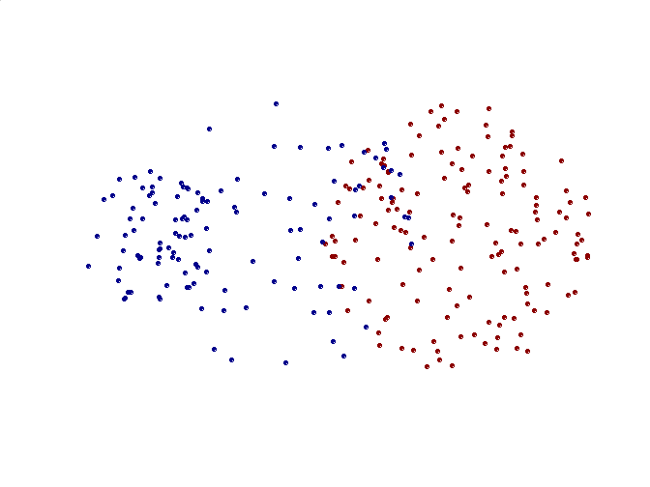
Limitations of MIN
Original Points
Two Clusters
Sensitive to noise and outliers

Slide 50

Cluster Similarity: MAX or Complete Linkage
Similarity of two clusters is based on the two least similar (most distant) points in the different clusters
  Determined by all pairs of points in the two clusters
1
2
3
4
5

Slide 51
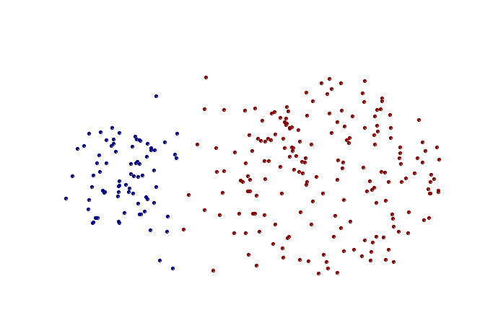
Strength of MAX
Original Points
Two Clusters
Less susceptible to noise and outliers

Slide 52
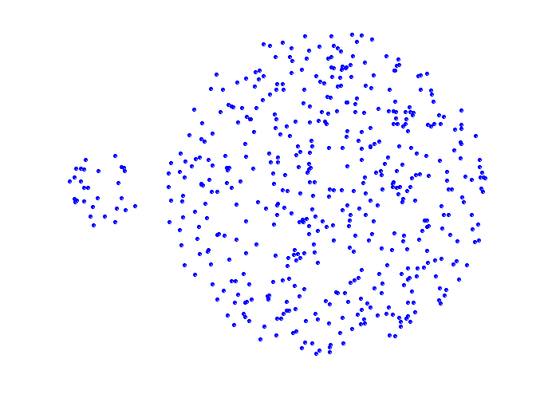
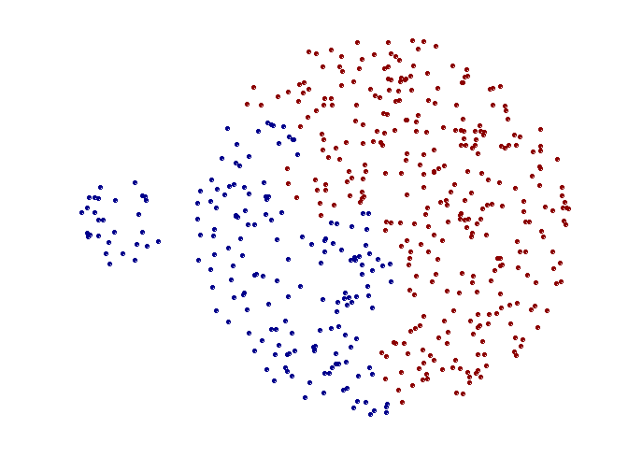
Limitations of MAX
Original Points
Two Clusters
Tends to break large clusters
Biased towards globular clusters (globular -- küresel)

Slide 53
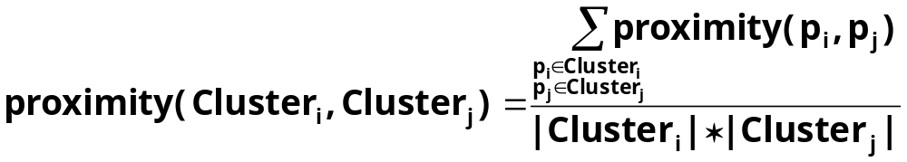

Cluster Similarity: Group Average
Proximity of two clusters is the average of pairwise proximity between points in the two clusters.
Need to use average connectivity for scalability since total proximity favors large clusters
1
2
3
4
5

Slide 54

Hierarchical Clustering: Group Average
5
4
1
2
5
2
3
6
1
4
3
Nested Clusters
Dendrogram

Slide 55
Hierarchical Clustering: Group Average
Compromise between Single and Complete Link
Strengths
  Less susceptible to noise and outliers
Limitations
  Biased towards globular (küresel) clusters

Slide 56
Cluster Similarity: Ward’s Method
Similarity of two clusters is based on the increase in squared error when two clusters are merged
  Similar to group average if distance between points is distance squared
Less susceptible to noise and outliers
Biased towards globular clusters
Hierarchical analogue of K-means
  Can be used to initialize K-means

Slide 57
Cluster Validity
For supervised classification we have a variety of measures to evaluate how good our model is
  Accuracy, precision, recall
For cluster analysis, the analogous question is how to evaluate the “goodness” of the resulting clusters?
But “clusters are in the eye of the beholder”!
Then why do we want to evaluate them?
  To avoid finding patterns in noise
  To compare clustering algorithms
  To compare two sets of clusters
  To compare two clusters

Slide 58
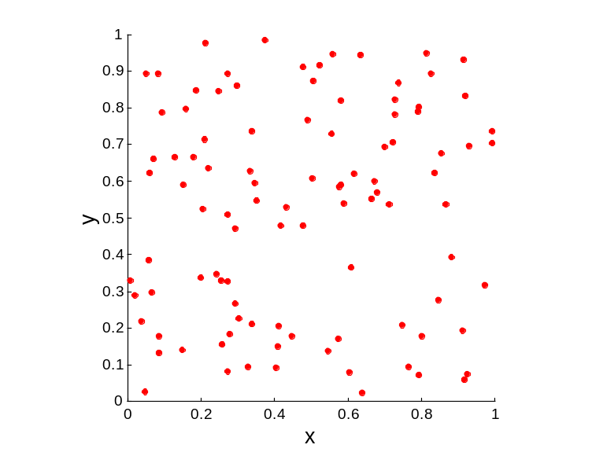
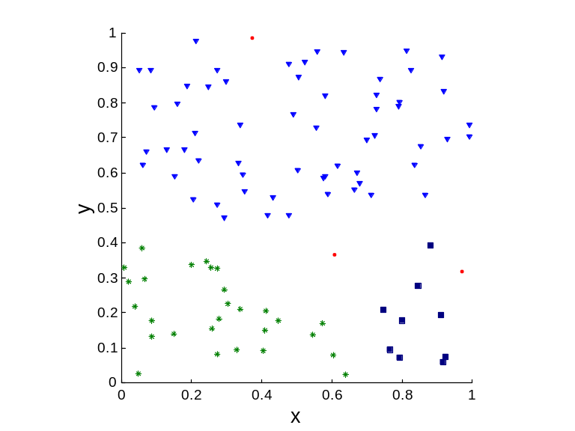
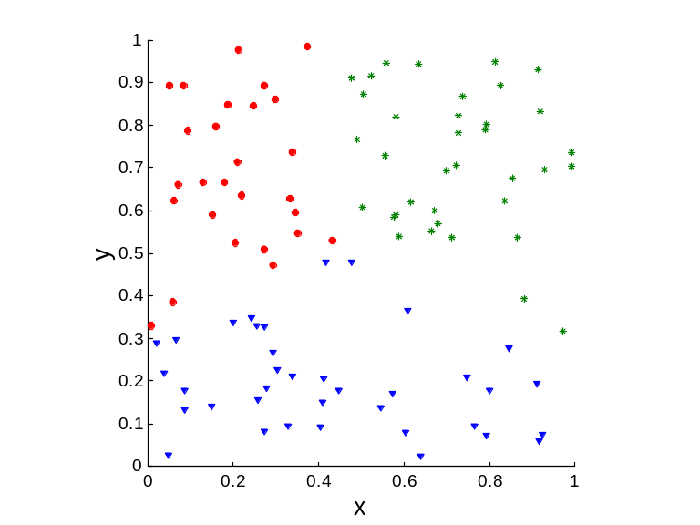
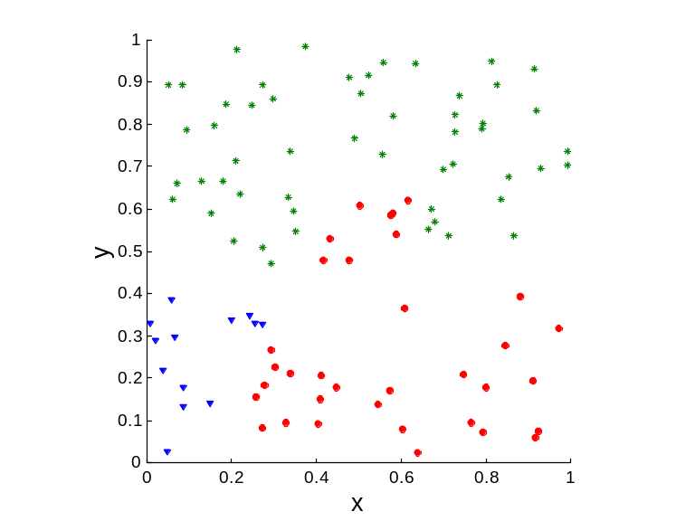
Clusters found in Random Data
Random Points
DBSCAN
K-means
Complete Link

Slide 59
Different Aspects of Cluster Validation
Determining the clustering tendency of a set of data, i.e., distinguishing whether non-random structure actually exists in the data.
Comparing the results of a cluster analysis to externally known results, e.g., to externally given class labels.
Evaluating how well the results of a cluster analysis fit the data without reference to external information.
  - Use only the data
Comparing the results of two different sets of cluster analyses to determine which is better.
Determining the ‘correct’ number of clusters.
For 2, 3, and 4, we can further distinguish whether we want to evaluate the entire clustering or just individual clusters.

Slide 60
Measures of Cluster Validity
Numerical measures that are applied to judge various aspects of cluster validity, are classified into the following three types.
  External Index: Used to measure the extent to which cluster labels match externally supplied class labels.
    Entropy
  Internal Index: Used to measure the goodness of a clustering structure without respect to external information.
    Sum of Squared Error (SSE)
  Relative Index: Used to compare two different clusterings or clusters.
    Often an external or internal index is used for this function, e.g., SSE or entropy
Sometimes these are referred to as criteria instead of indices
  However, sometimes criterion is the general strategy and index is the numerical measure that implements the criterion.

Slide 61
Measuring Cluster Validity Via Correlation
Two matrices
  Proximity Matrix (Yakınlık matrisi)
  “Incidence” Matrix (Tekrar Oranı Matrisi)
    One row and one column for each data point
    An entry is 1 if the associated pair of points belong to the same cluster
    An entry is 0 if the associated pair of points belongs to different clusters
Compute the correlation between the two matrices
  Since the matrices are symmetric, only the correlation between
  n(n-1) / 2 entries needs to be calculated.
High correlation indicates that points that belong to the same cluster are close to each other.
Not a good measure for some density or contiguity based clusters.

Slide 62
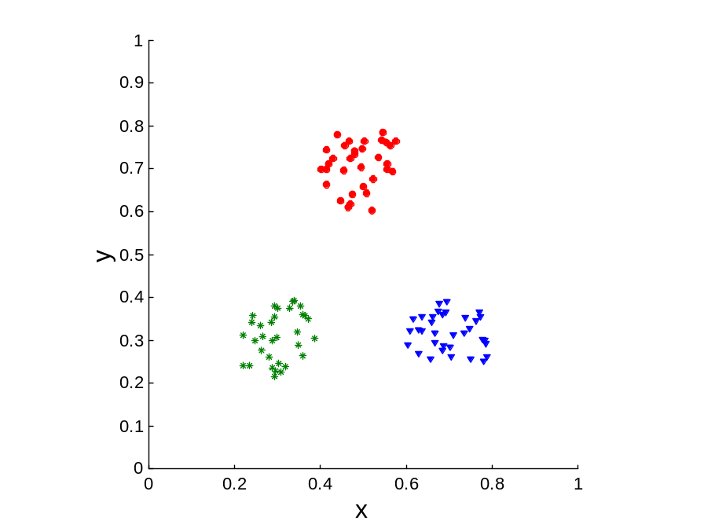
Measuring Cluster Validity Via Correlation
Correlation of incidence and proximity matrices for the K-means clusterings of the following two data sets.
Corr = -0.9235
Corr = -0.5810

Slide 63
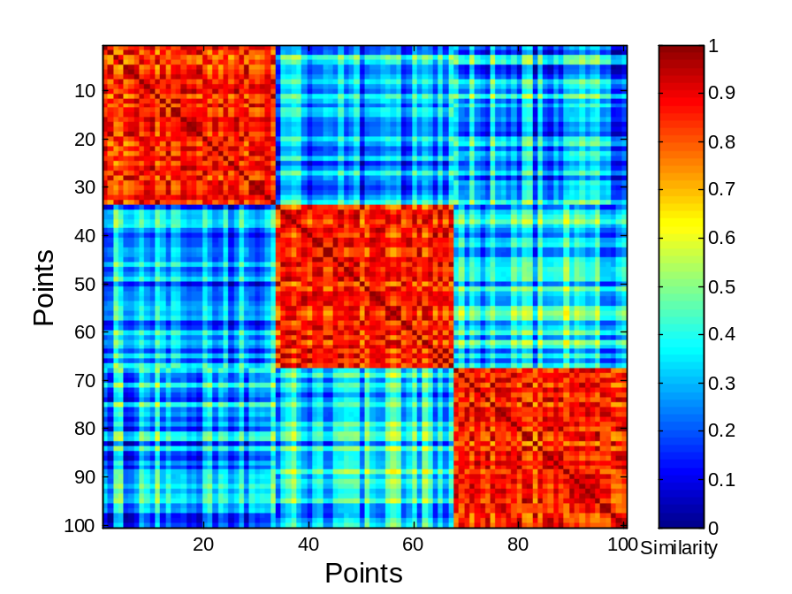
Using Similarity Matrix for Cluster Validation
Order the similarity matrix with respect to cluster labels and inspect visually.

Slide 64
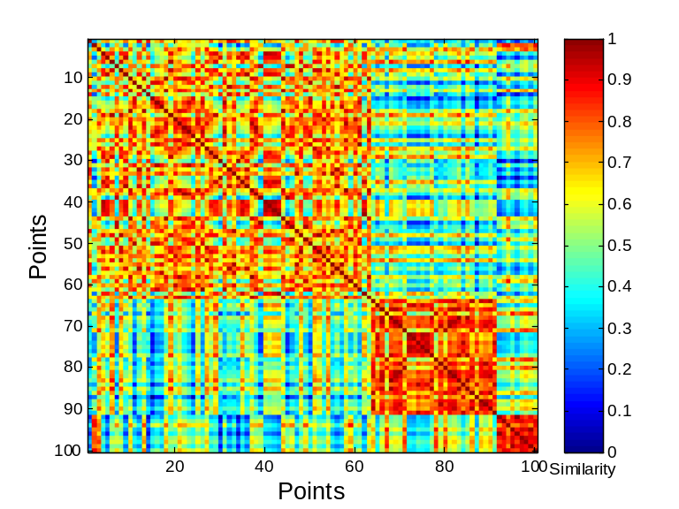
Using Similarity Matrix for Cluster Validation
Clusters in random data are not so crisp
DBSCAN

Slide 65
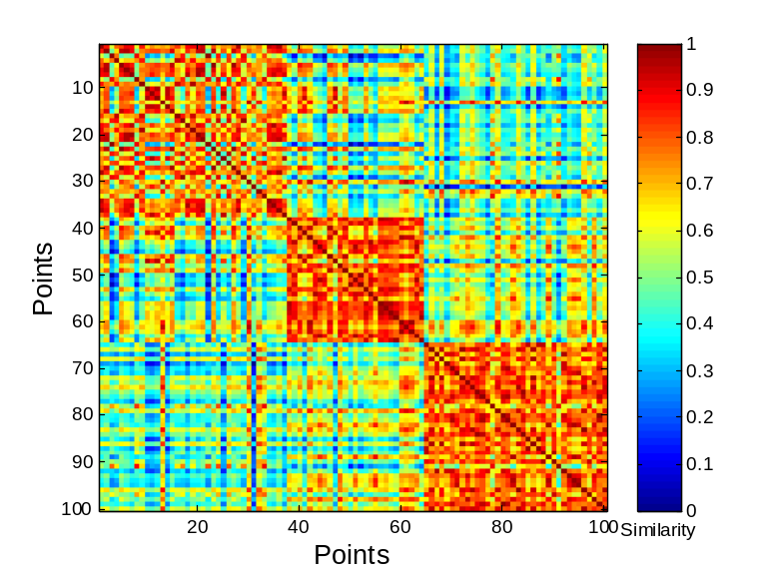
Using Similarity Matrix for Cluster Validation
Clusters in random data are not so crisp
K-means

Slide 66
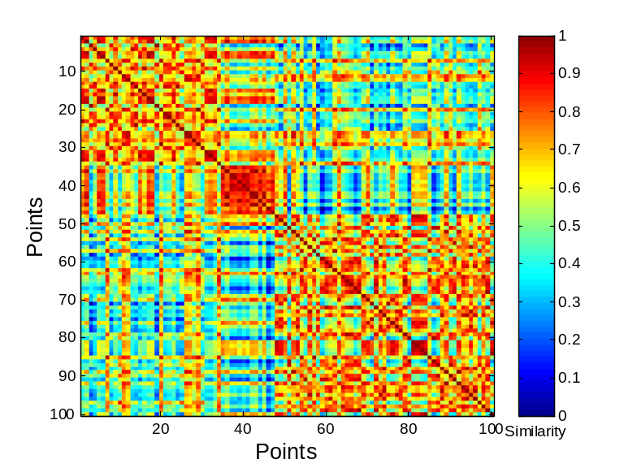
Using Similarity Matrix for Cluster Validation
Clusters in random data are not so crisp
Complete Link

Slide 67
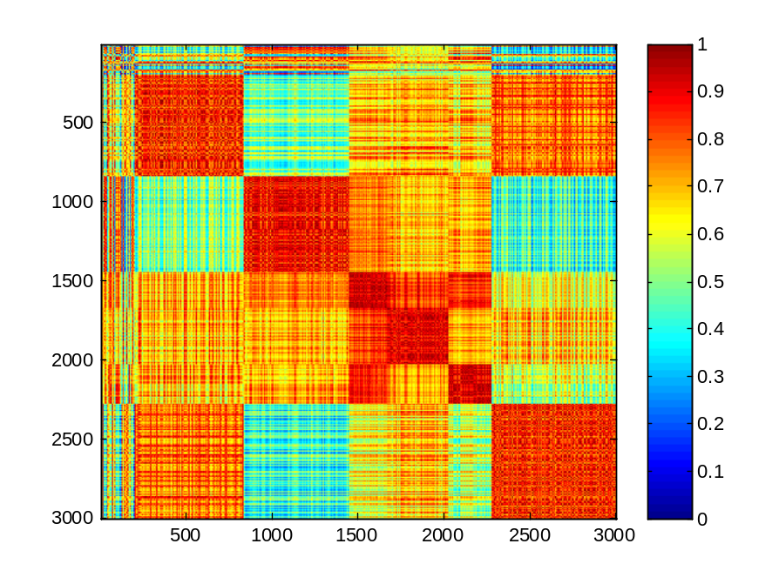
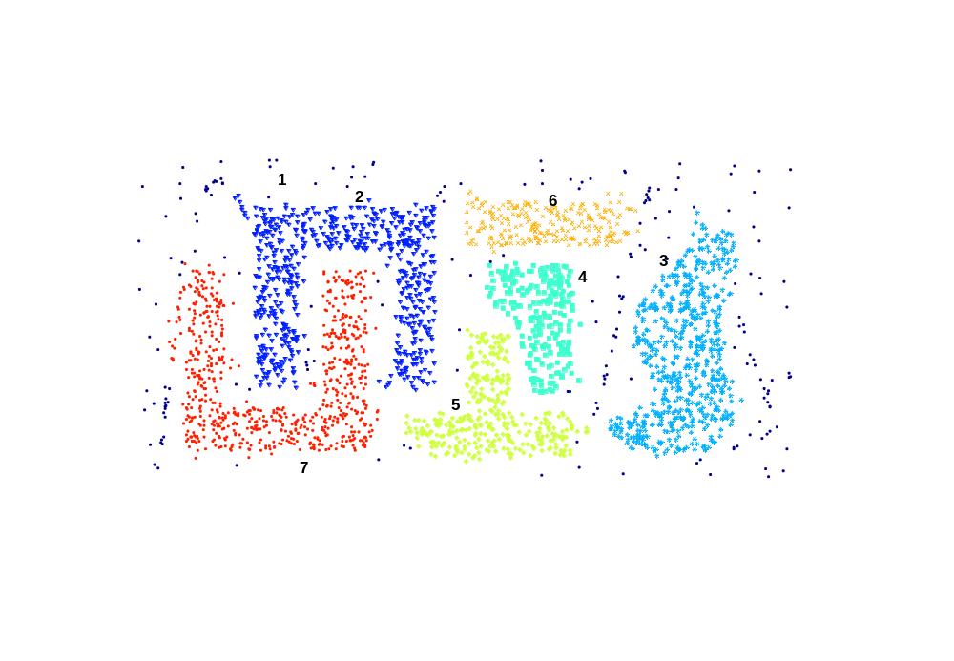
Using Similarity Matrix for Cluster Validation
DBSCAN

Slide 68
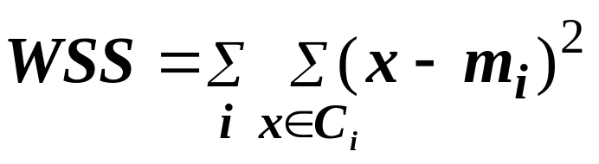
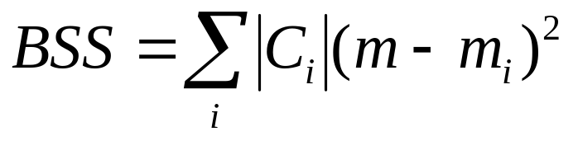
Internal Measures: Cohesion and Separation
Cluster Cohesion: Measures how closely related are objects in a cluster
  Example: SSE
Cluster Separation: Measure how distinct or well-separated a cluster is from other clusters
Example: Squared Error
  Cohesion is measured by the within cluster sum of squares (SSE)
  Separation is measured by the between cluster sum of squares
      Where |C_{i}| is the size of cluster i

Slide 69
Extra

Slide 70
Hierarchical Clustering: Comparison
5
1
4
1
3
2
5
5
5
2
1
MIN
2
MAX
2
3
6
3
3
6
1
4
4
4
5
5
1
4
1
2
2
5
2
Ward’s Method
5
2
3
6
Group Average
3
3
6
4
1
1
4
4
3

Slide 71
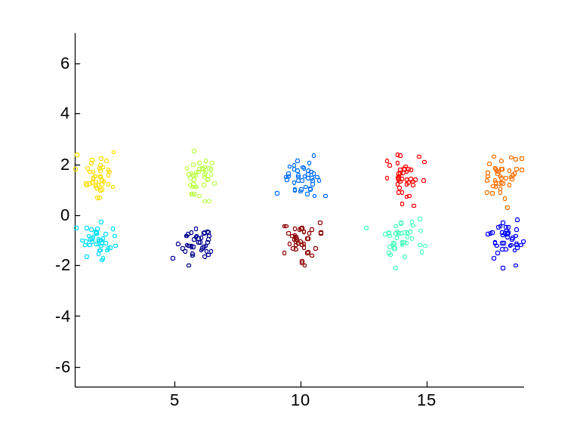
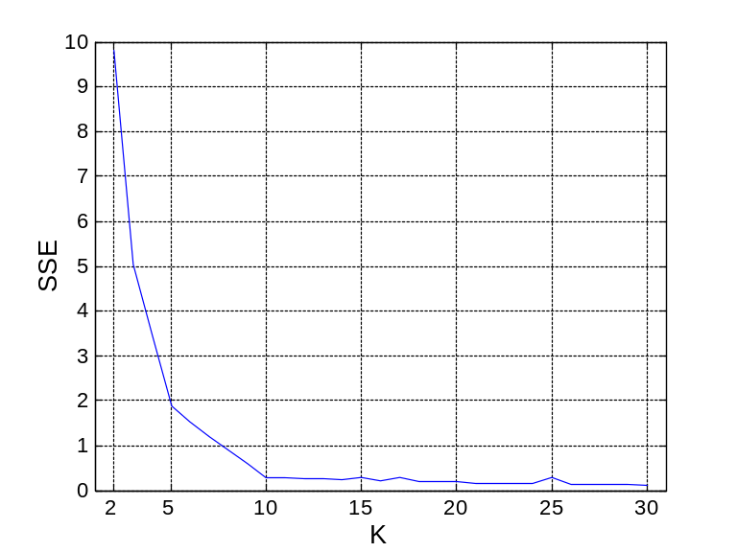
Internal Measures: SSE
Clusters in more complicated figures aren’t well separated
Internal Index: Used to measure the goodness of a clustering structure without respect to external information
  SSE
SSE is good for comparing two clusterings or two clusters (average SSE).
Can also be used to estimate the number of clusters

Slide 72
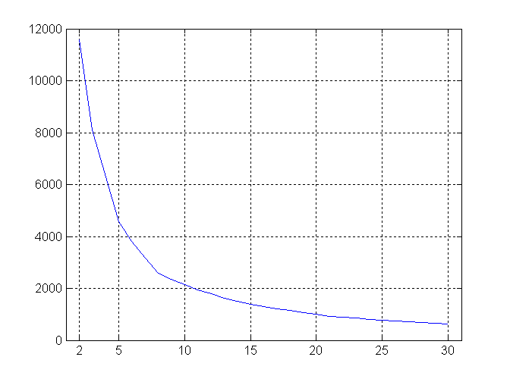
Internal Measures: SSE
SSE curve for a more complicated data set
SSE of clusters found using K-means

Slide 73
Framework for Cluster Validity
Need a framework to interpret any measure.
  For example, if our measure of evaluation has the value, 10, is that good, fair, or poor?
Statistics provide a framework for cluster validity
  The more “atypical” a clustering result is, the more likely it represents valid structure in the data
  Can compare the values of an index that result from random data or clusterings to those of a clustering result.
    If the value of the index is unlikely, then the cluster results are valid
  These approaches are more complicated and harder to understand.
For comparing the results of two different sets of cluster analyses, a framework is less necessary.
  However, there is the question of whether the difference between two index values is significant

Slide 74
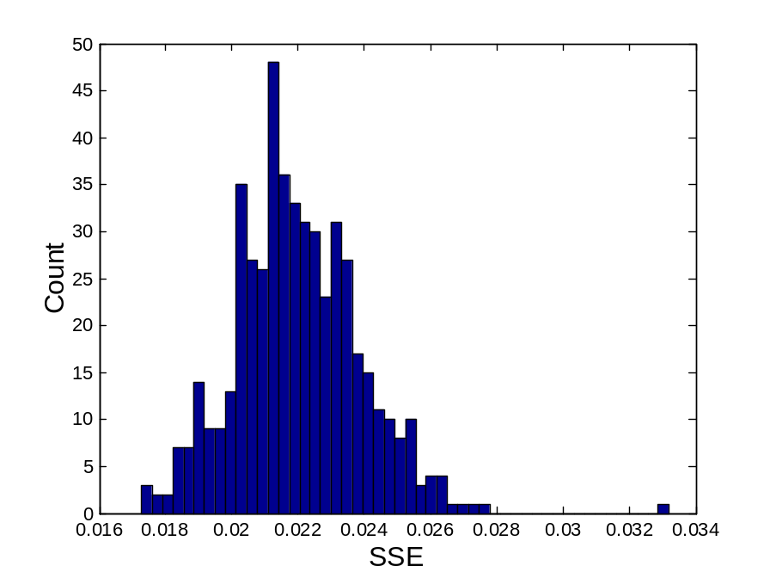
Statistical Framework for SSE
Example
  Compare SSE of 0.005 against three clusters in random data
  Histogram shows SSE of three clusters in 500 sets of random data points of size 100 distributed over the range 0.2 – 0.8 for x and y values

Slide 75
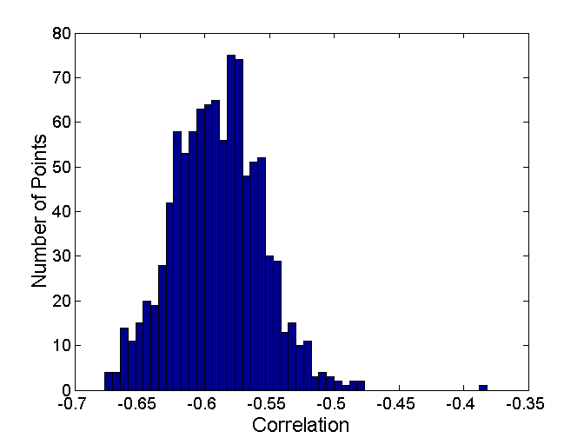
Statistical Framework for Correlation
Correlation of incidence and proximity matrices for the K-means clusterings of the following two data sets.
Corr = -0.9235
Corr = -0.5810

